Slide 1
Apple Laptop Setup
Rowan-salisbury Schools

Slide 2
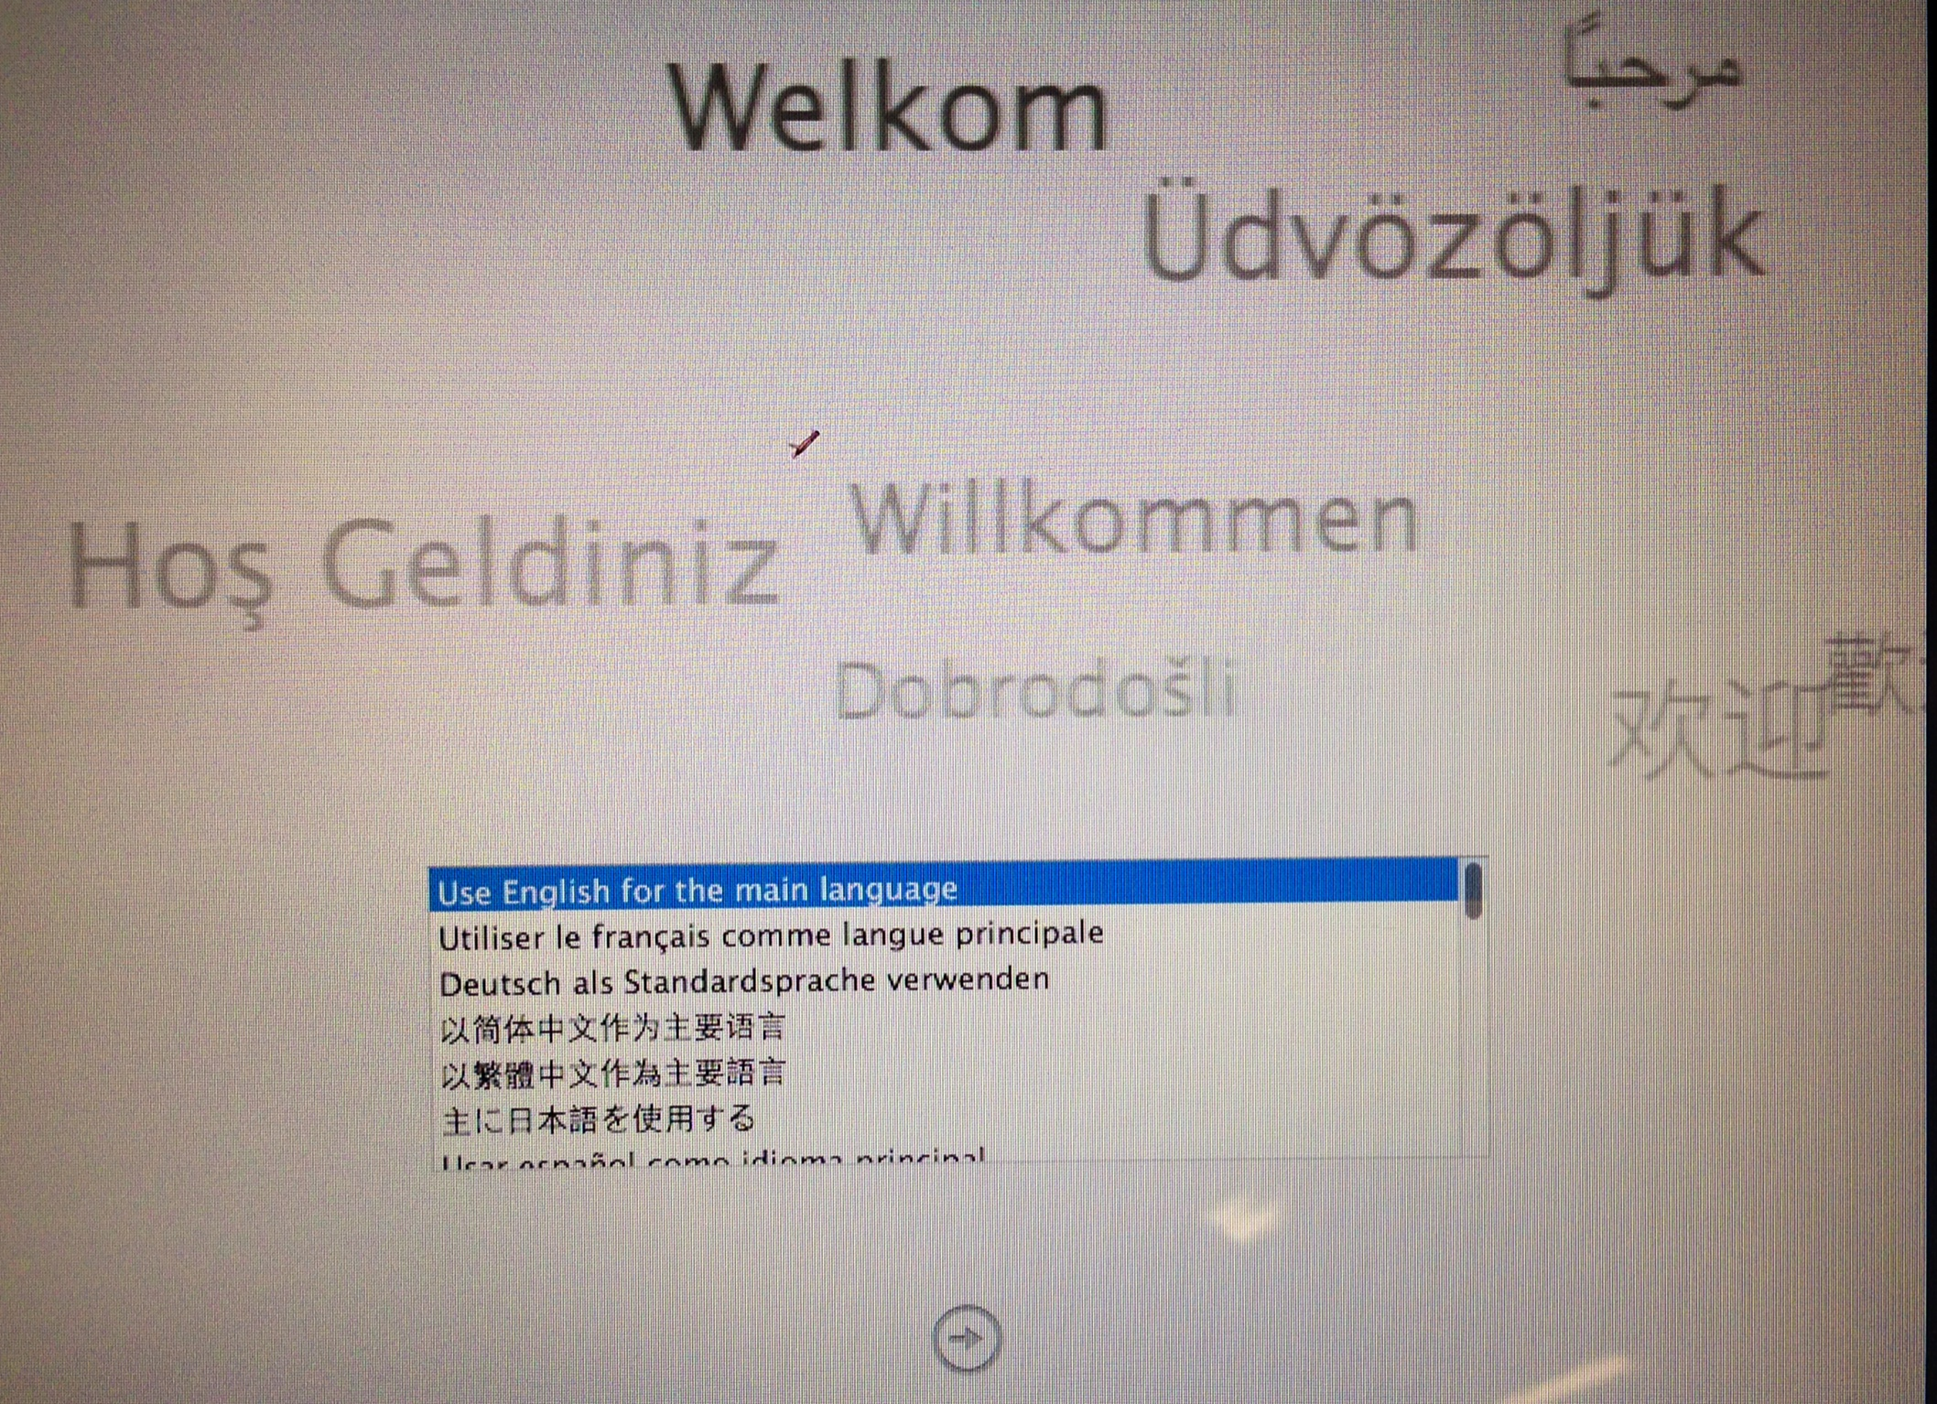

Slide 3
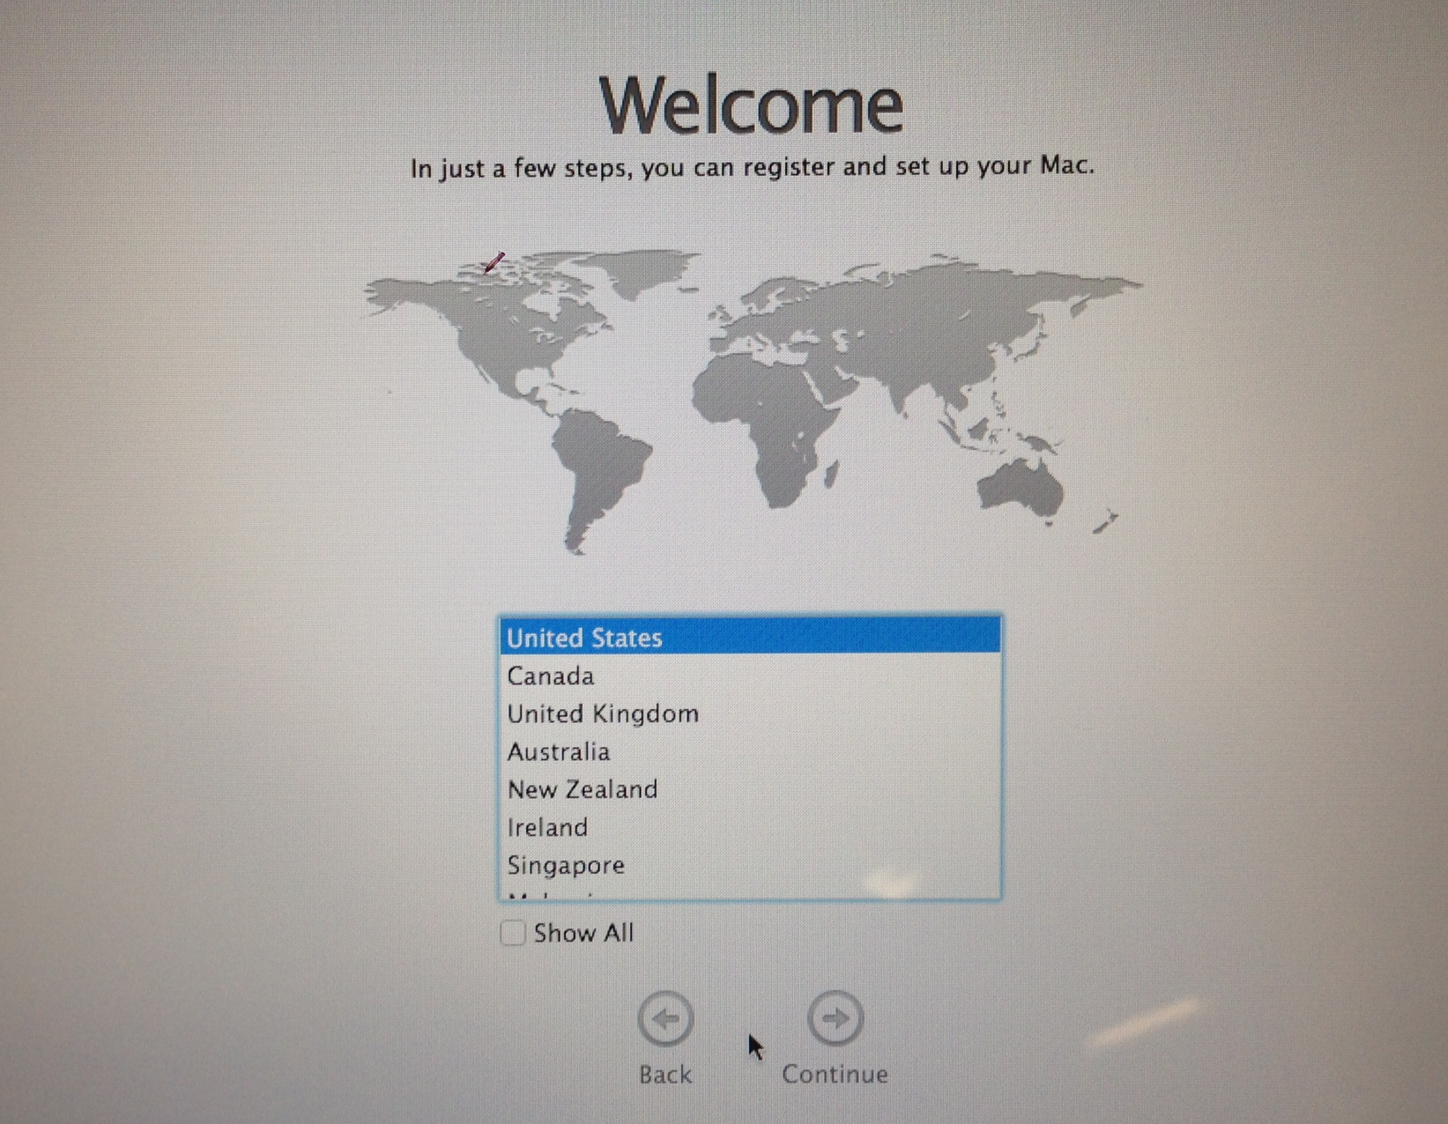

Slide 4
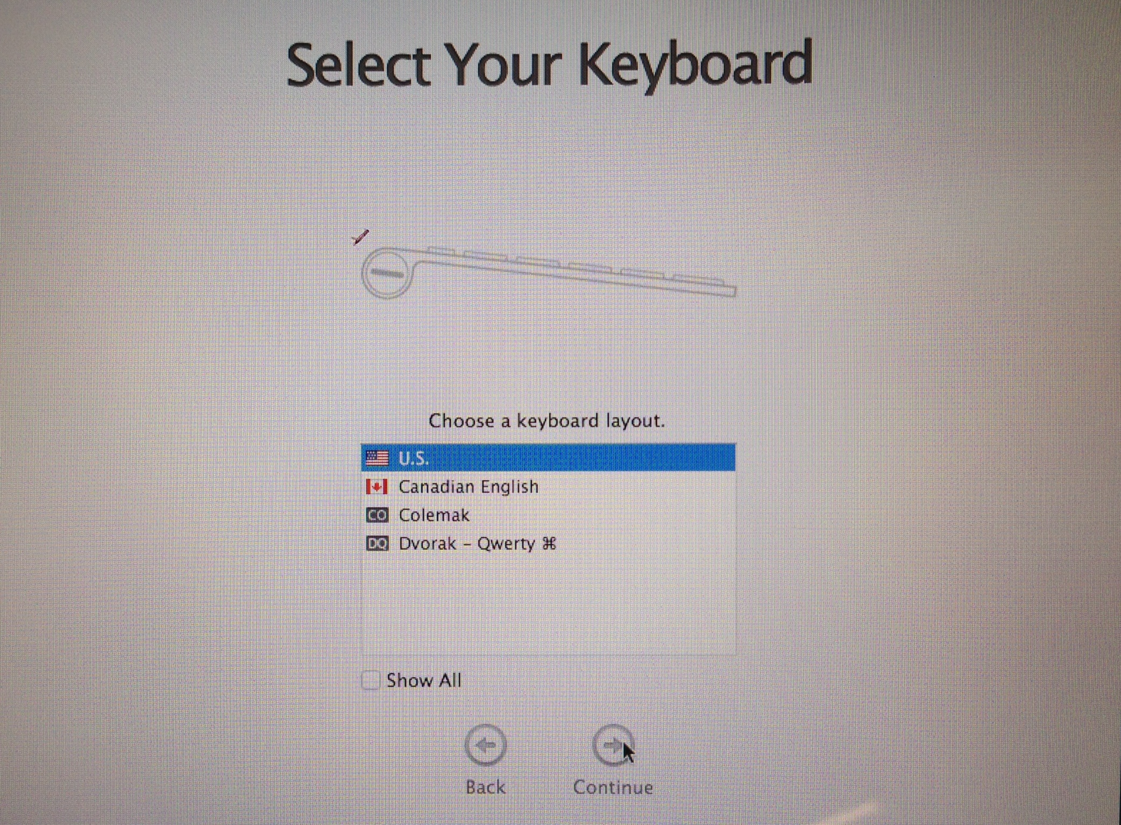

Slide 5
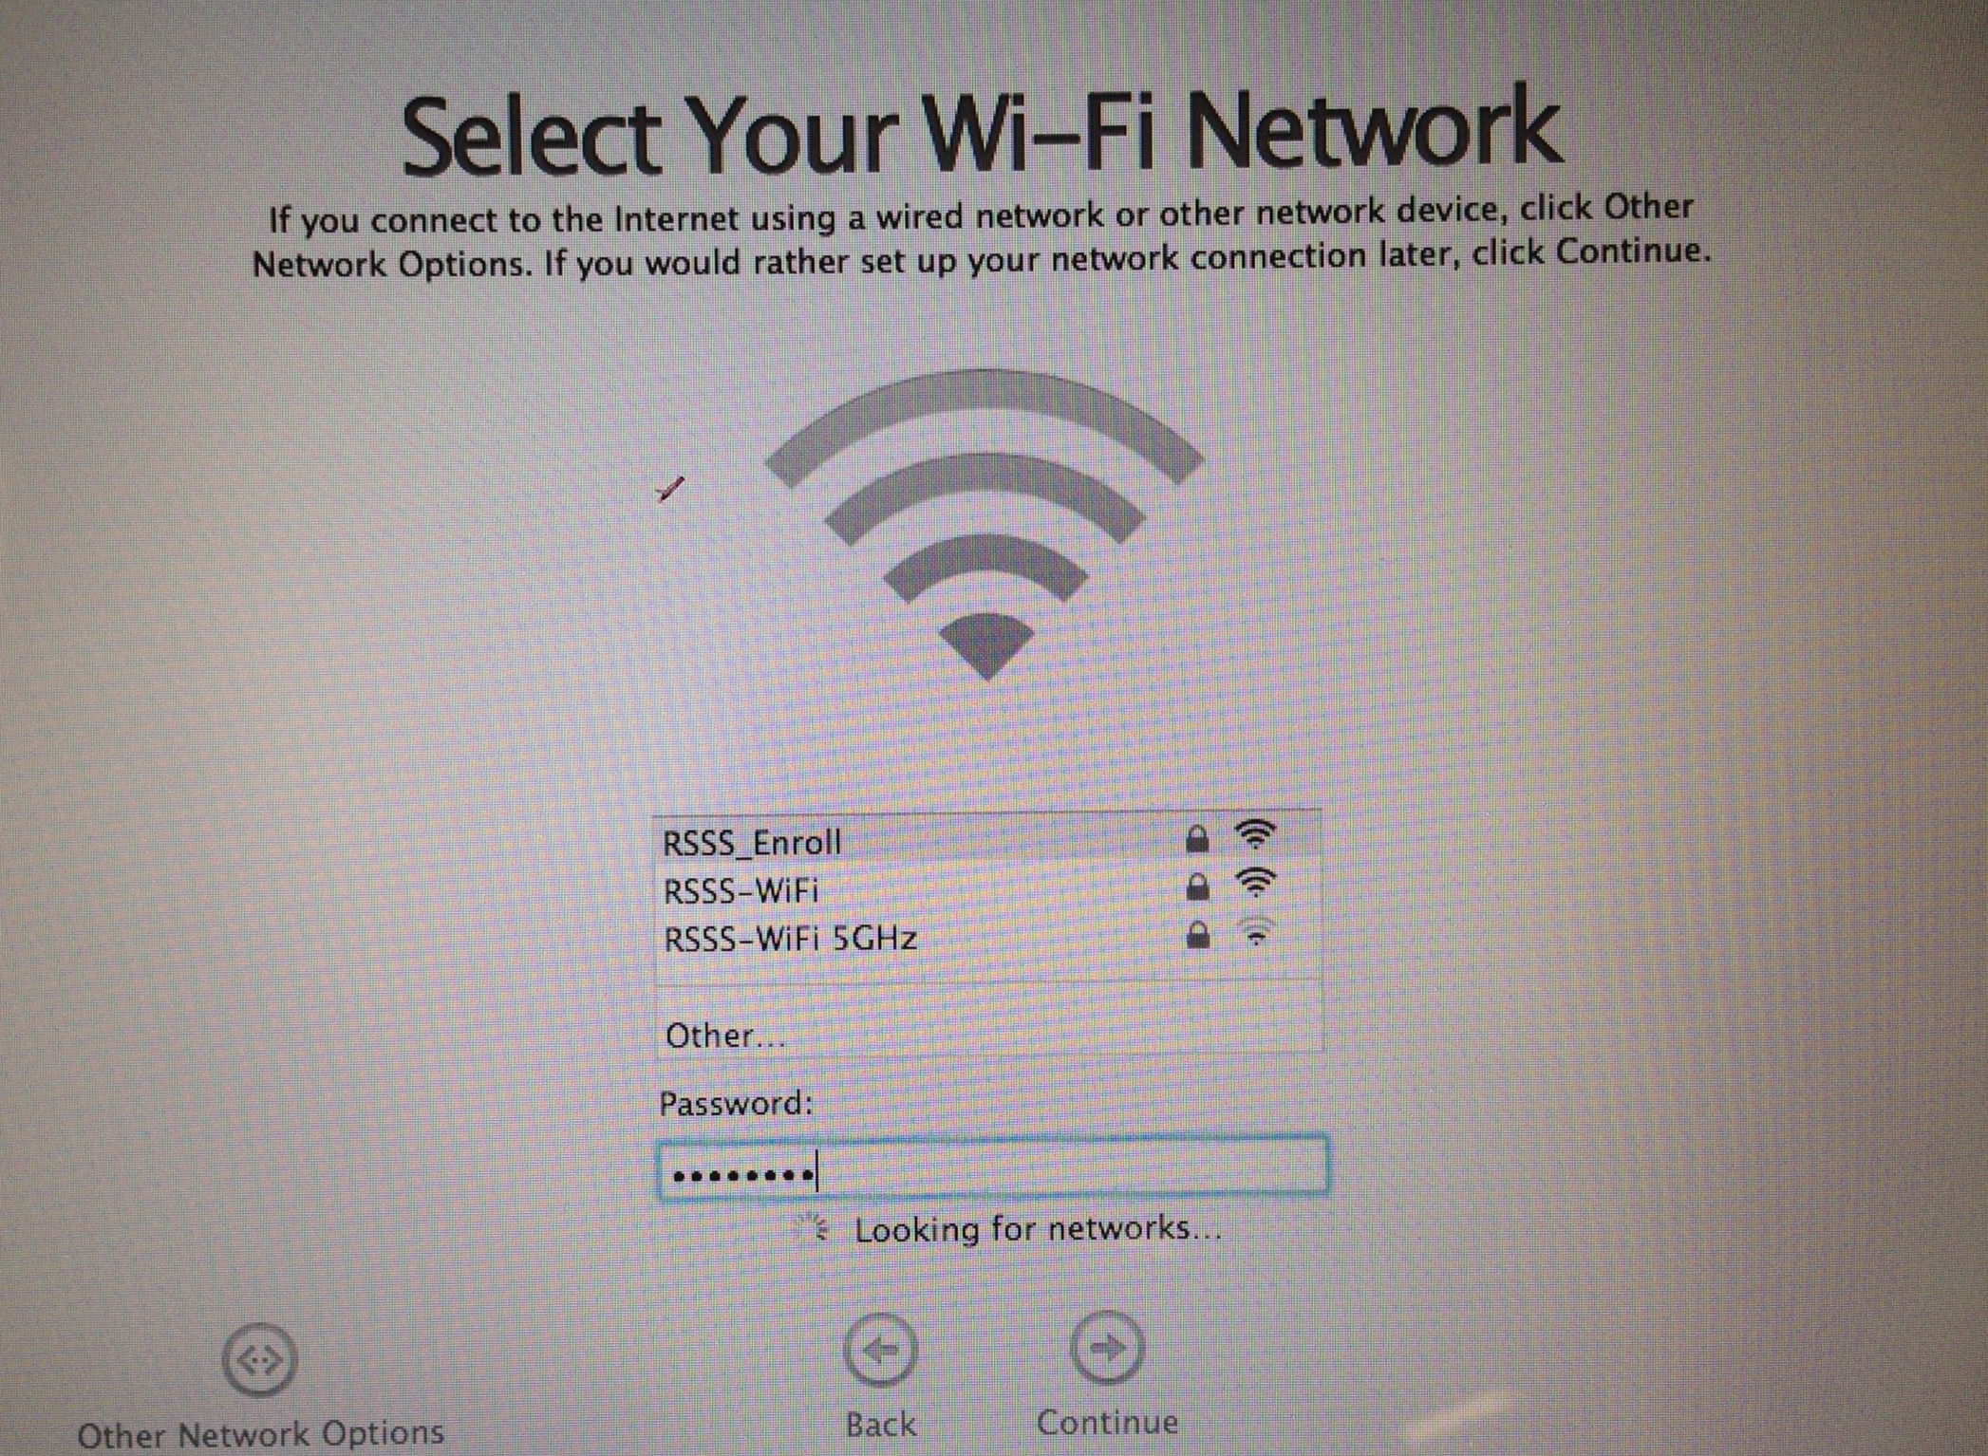
TF Enroll
enroll15

Slide 7
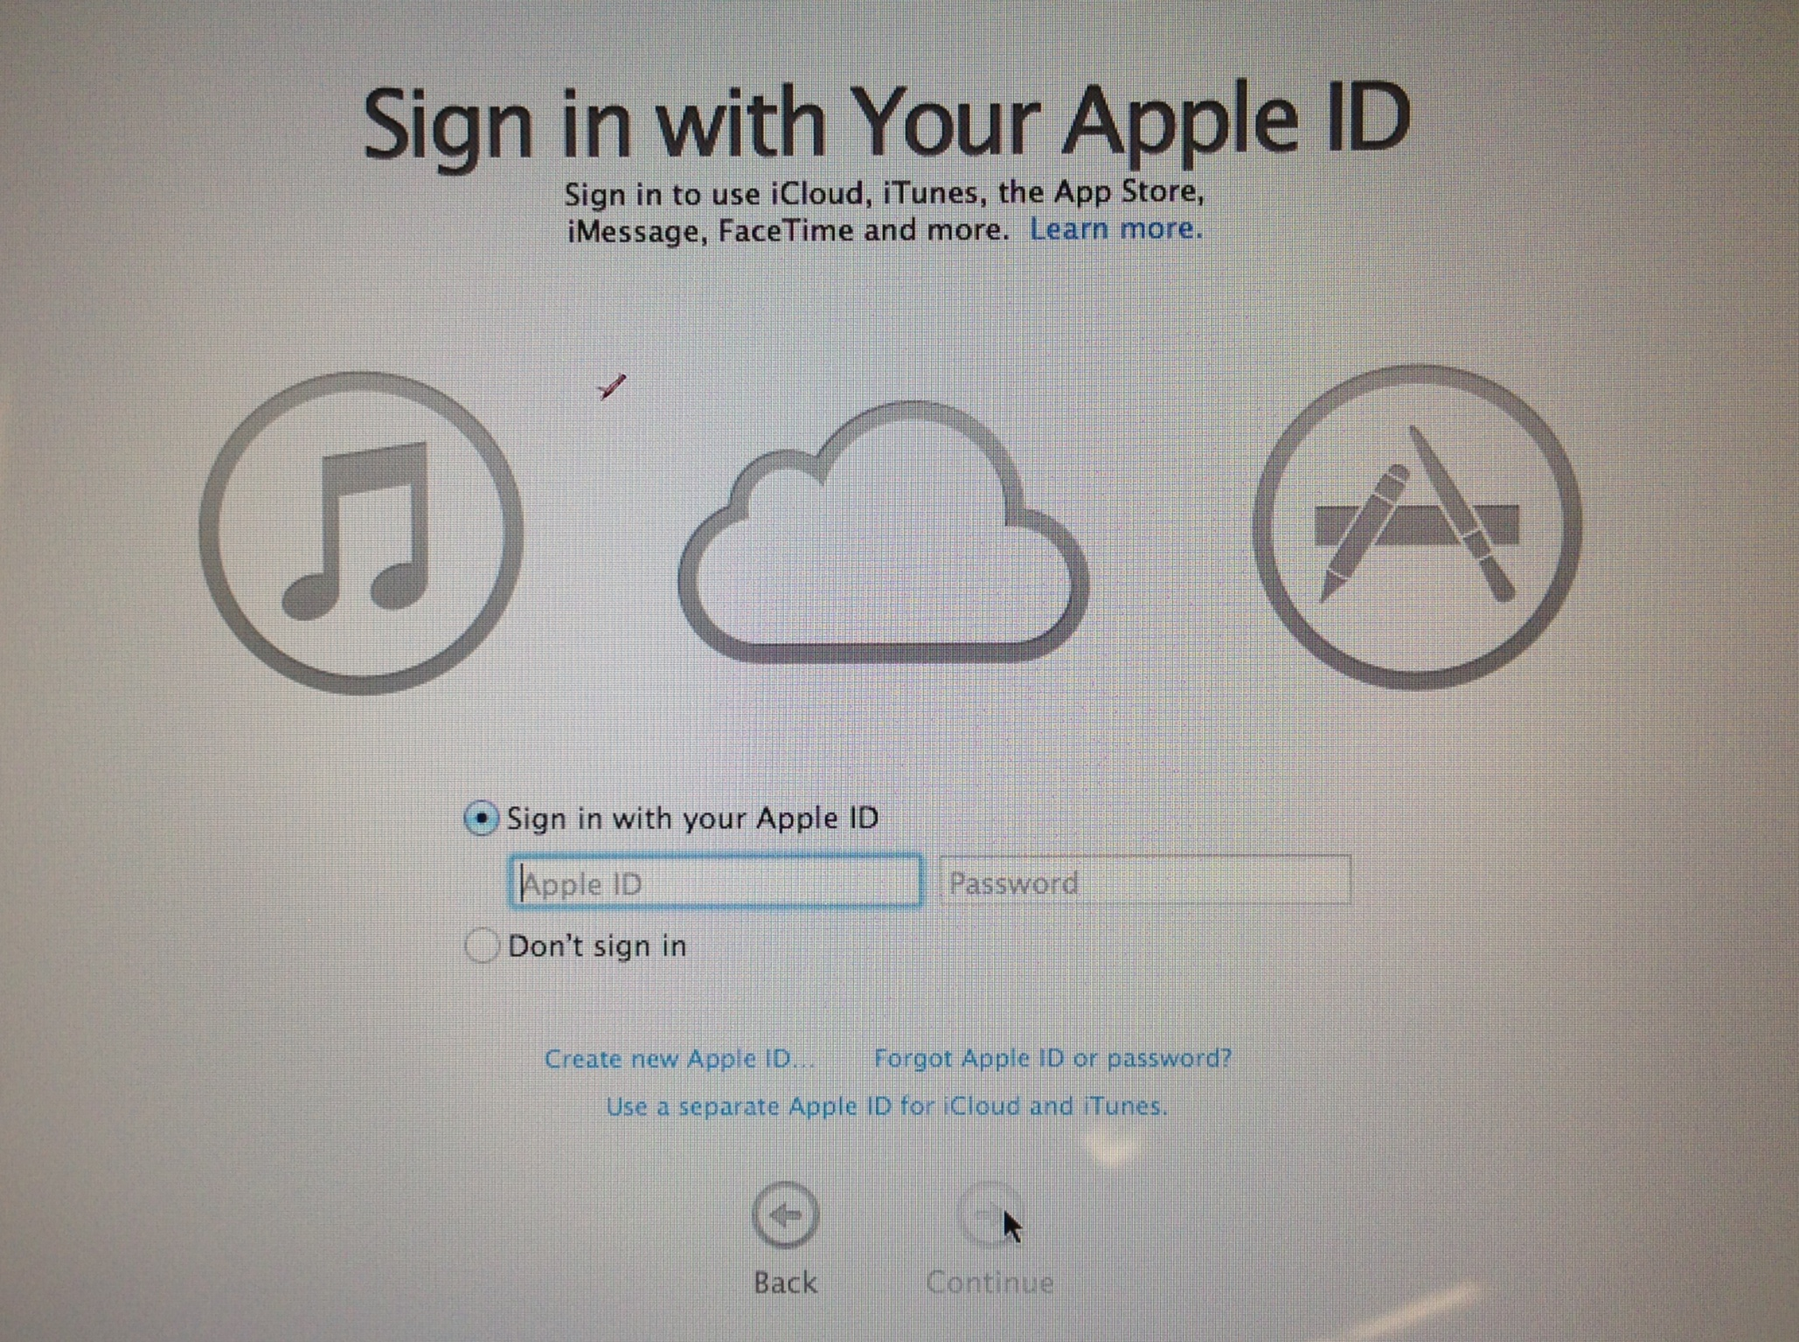
Then SKIP

Slide 8
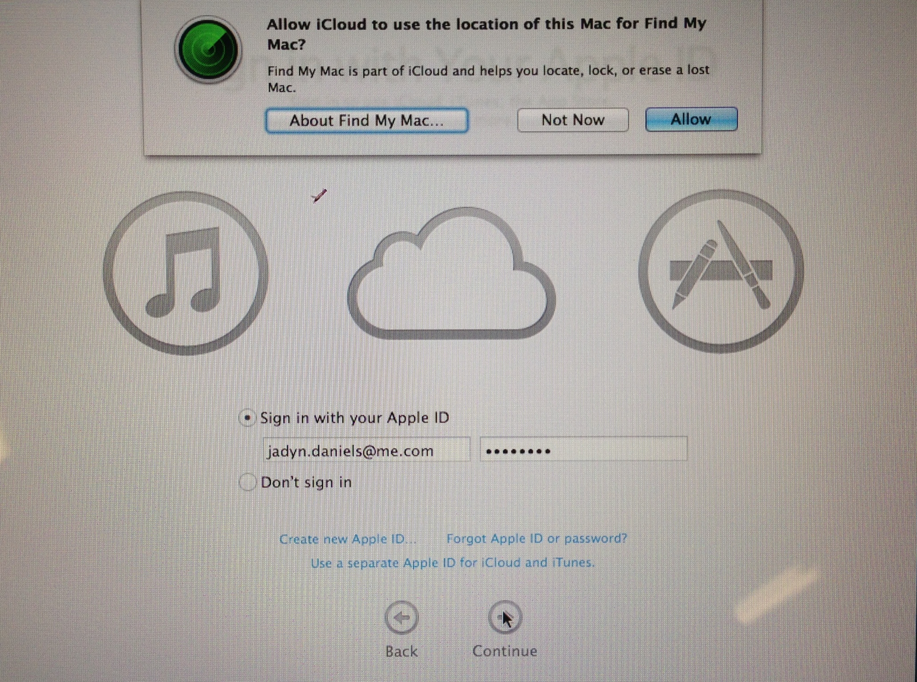

Slide 9
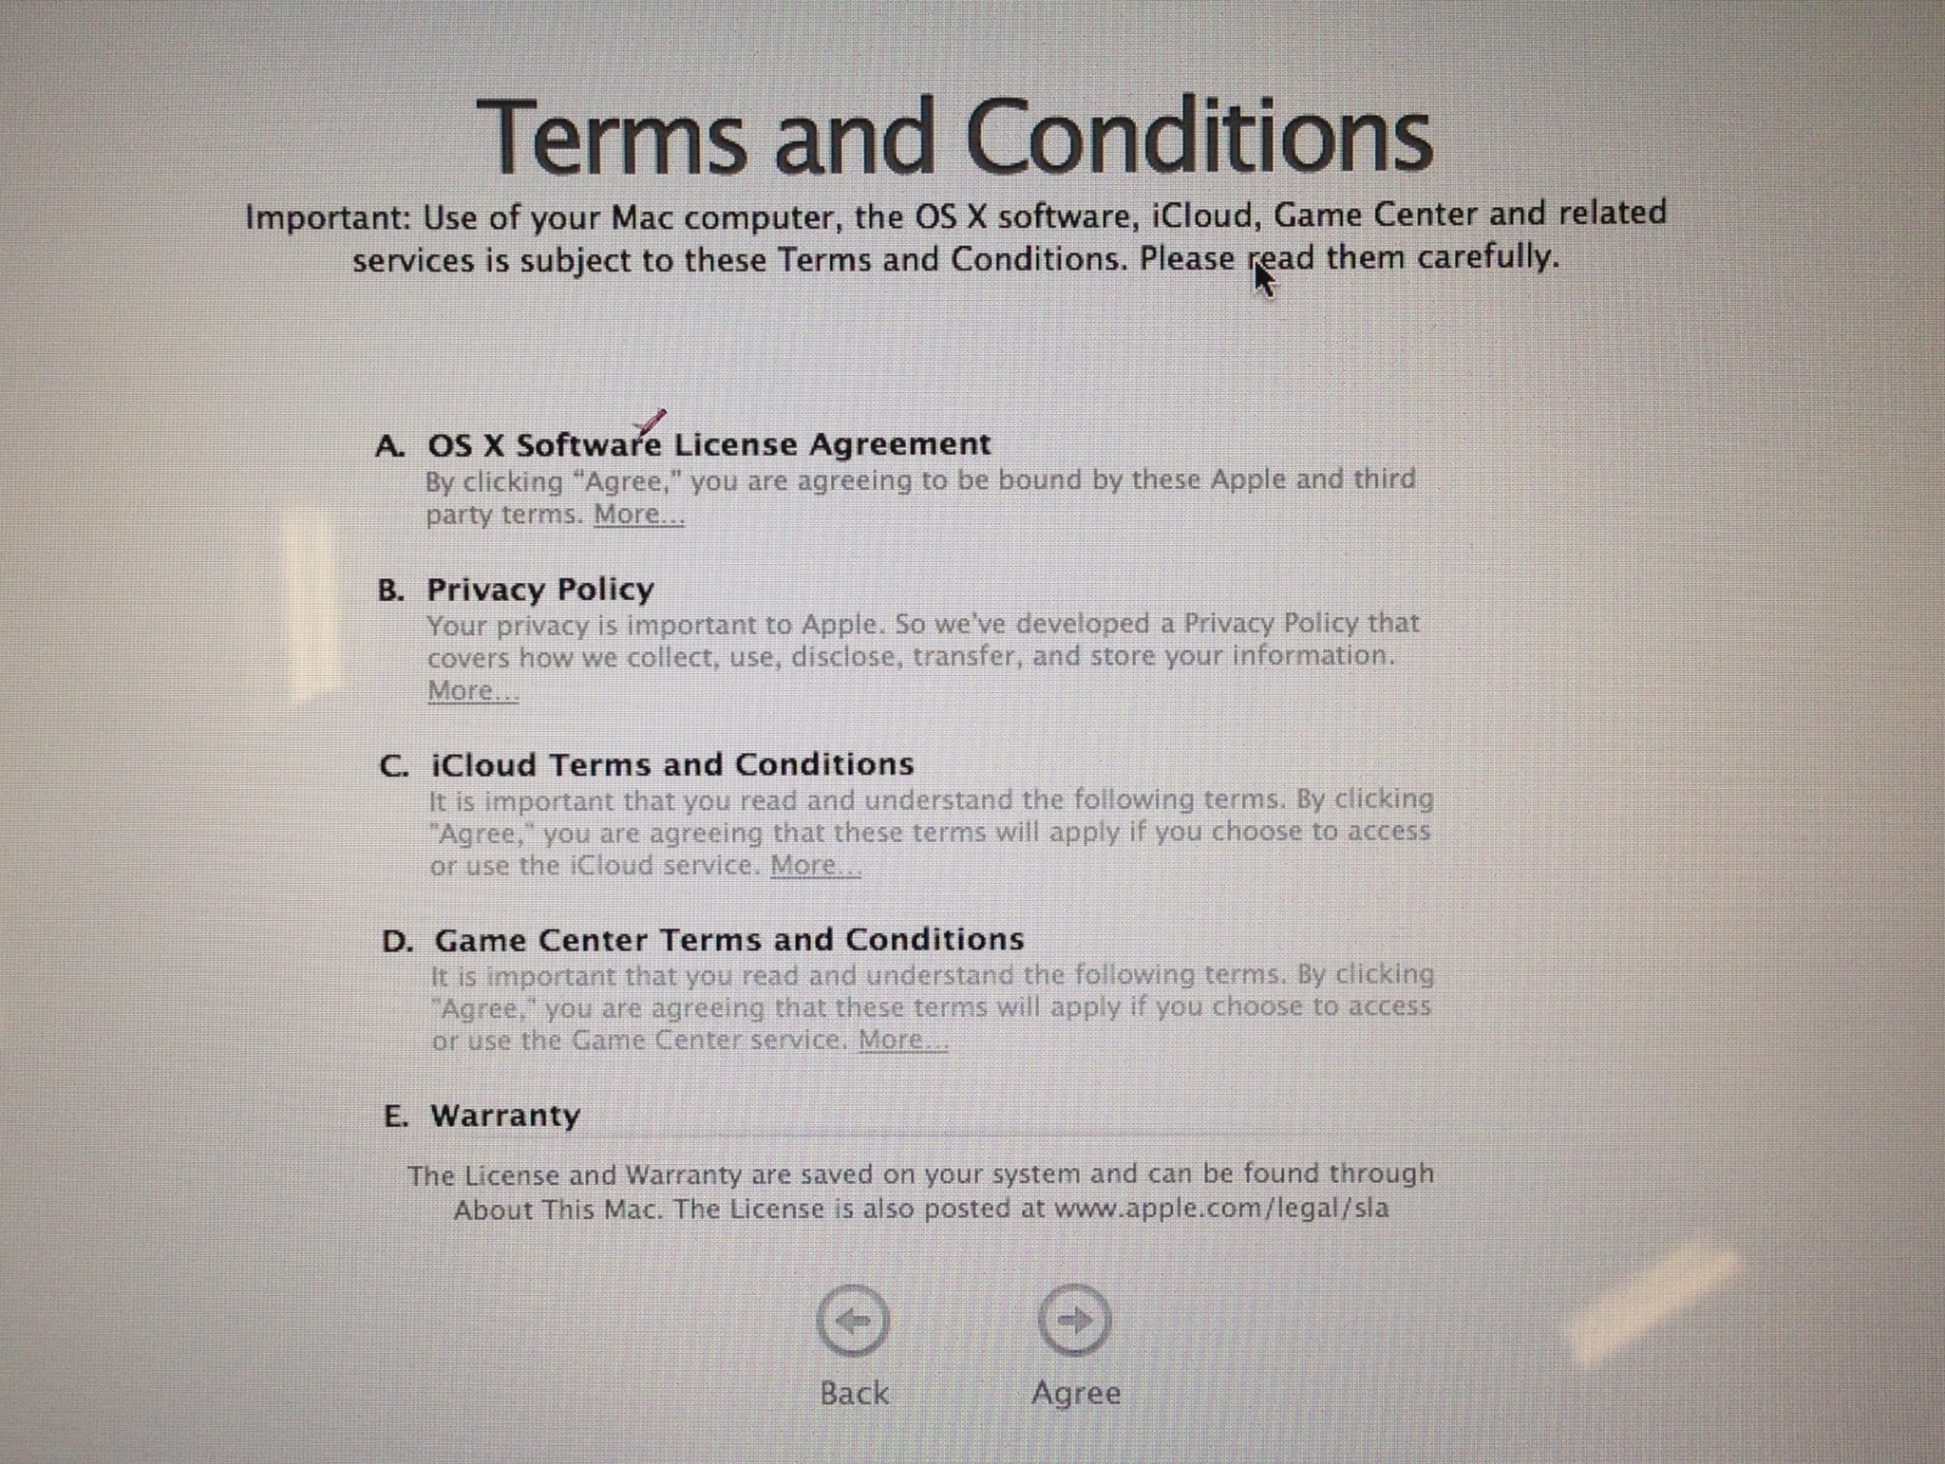

Slide 10
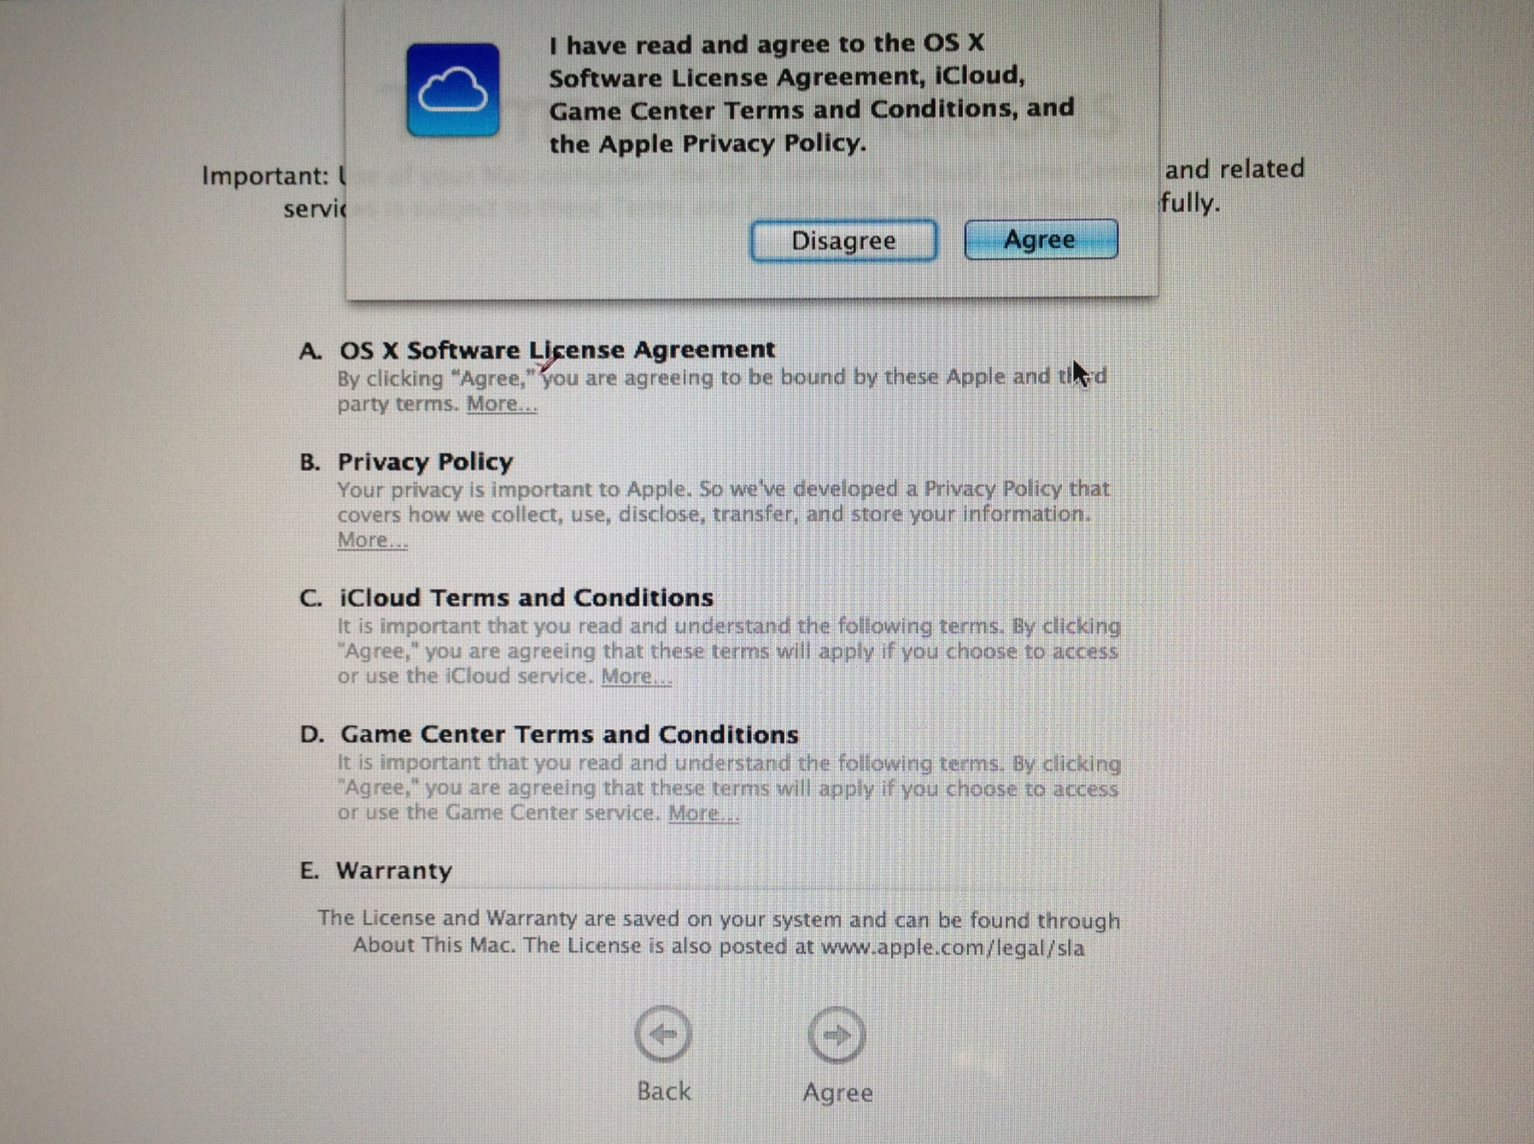

Slide 11
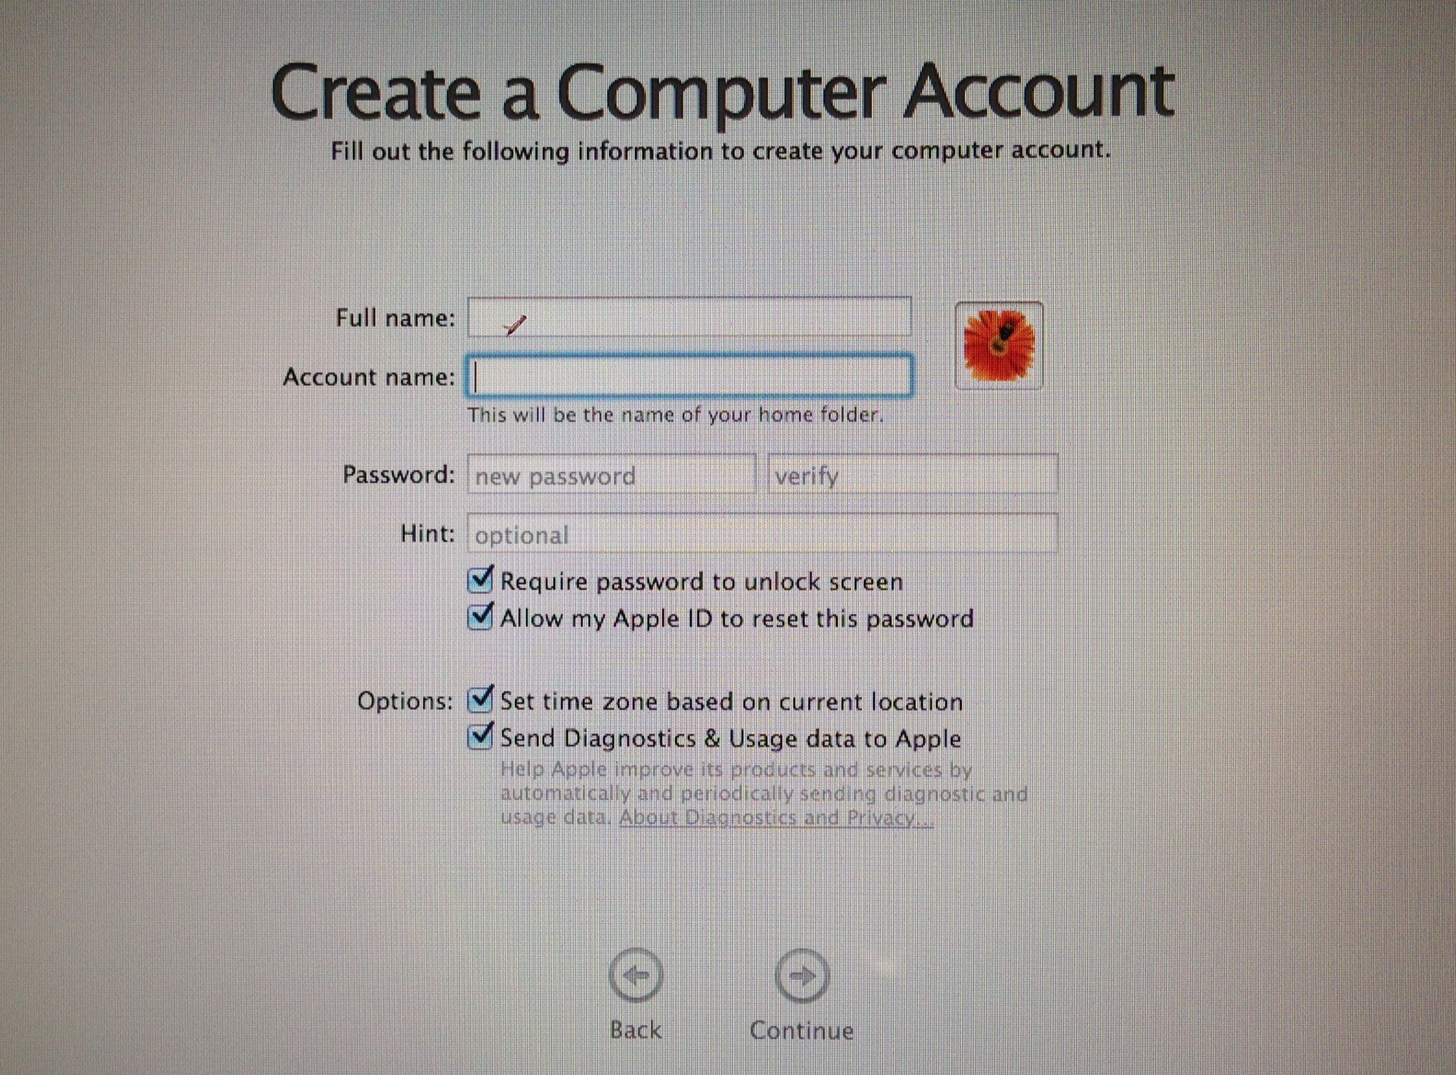
(Step 1) Full Name
Candace Andrew Clark
(Step 2) Last Name
First Initial
Middle Initial
ClarkCA
MUST BE your STUDENT ID#
(Step 3) Password & Hint

Slide 12
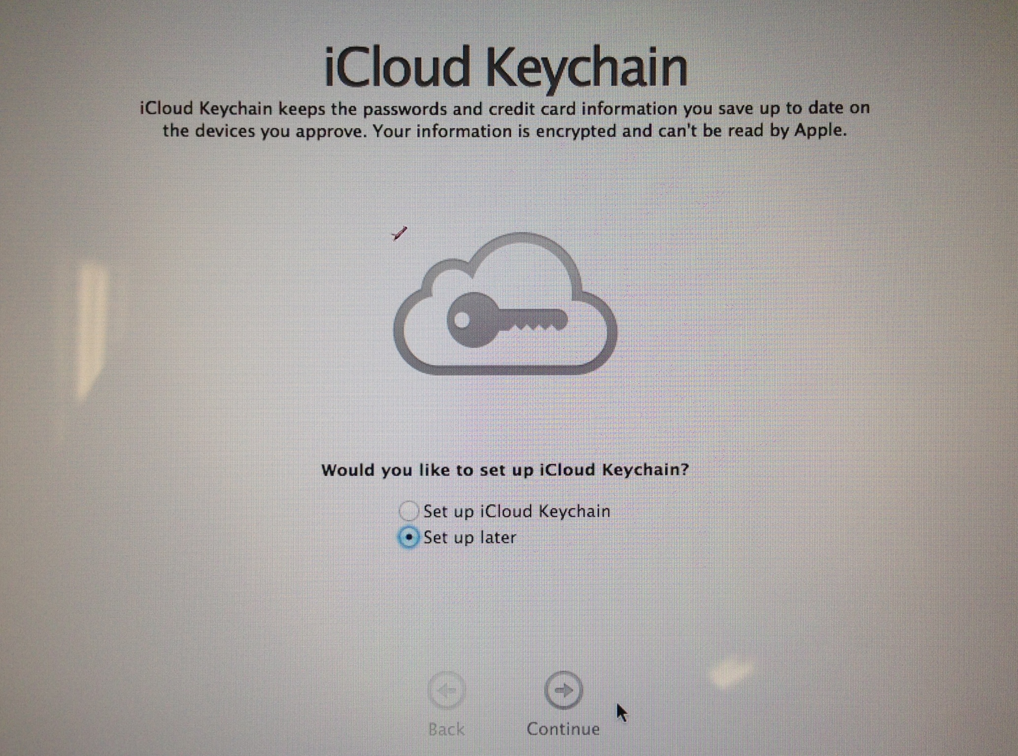

Slide 13
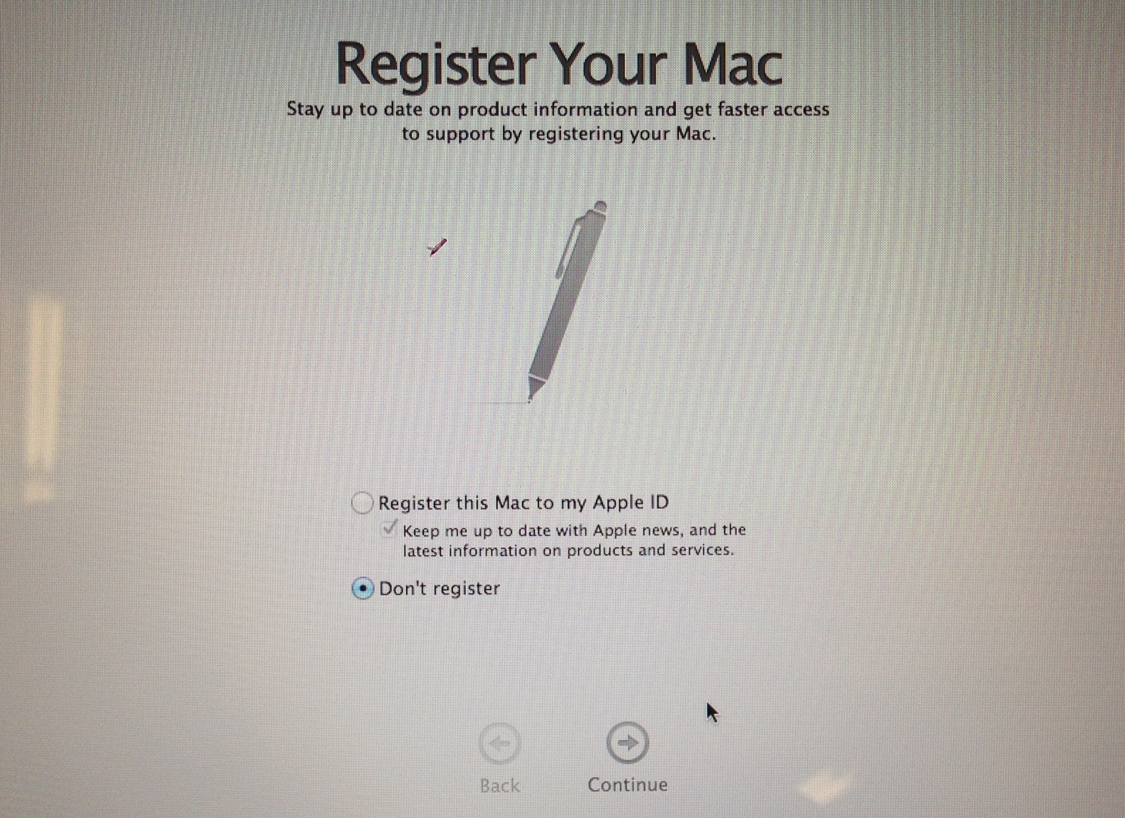

Slide 14
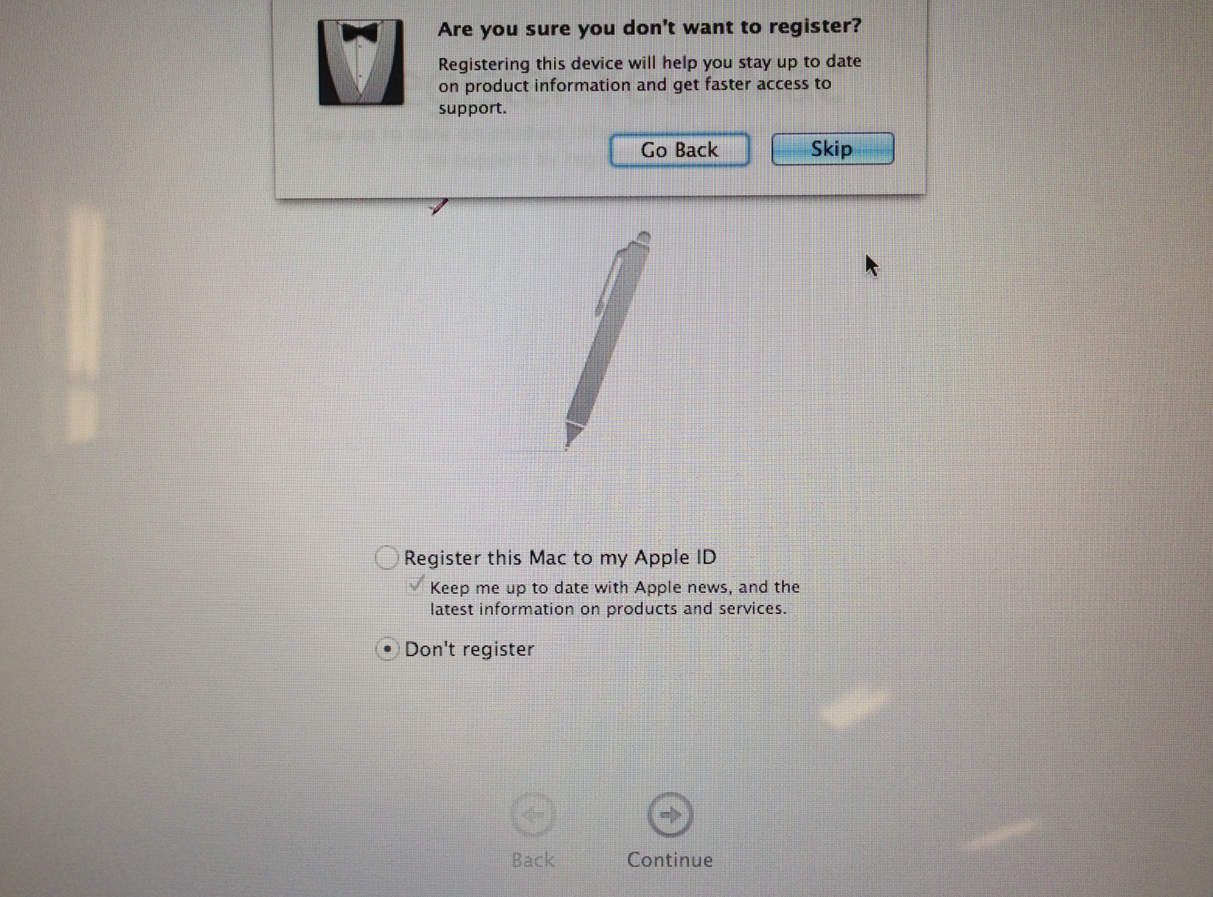

Slide 15
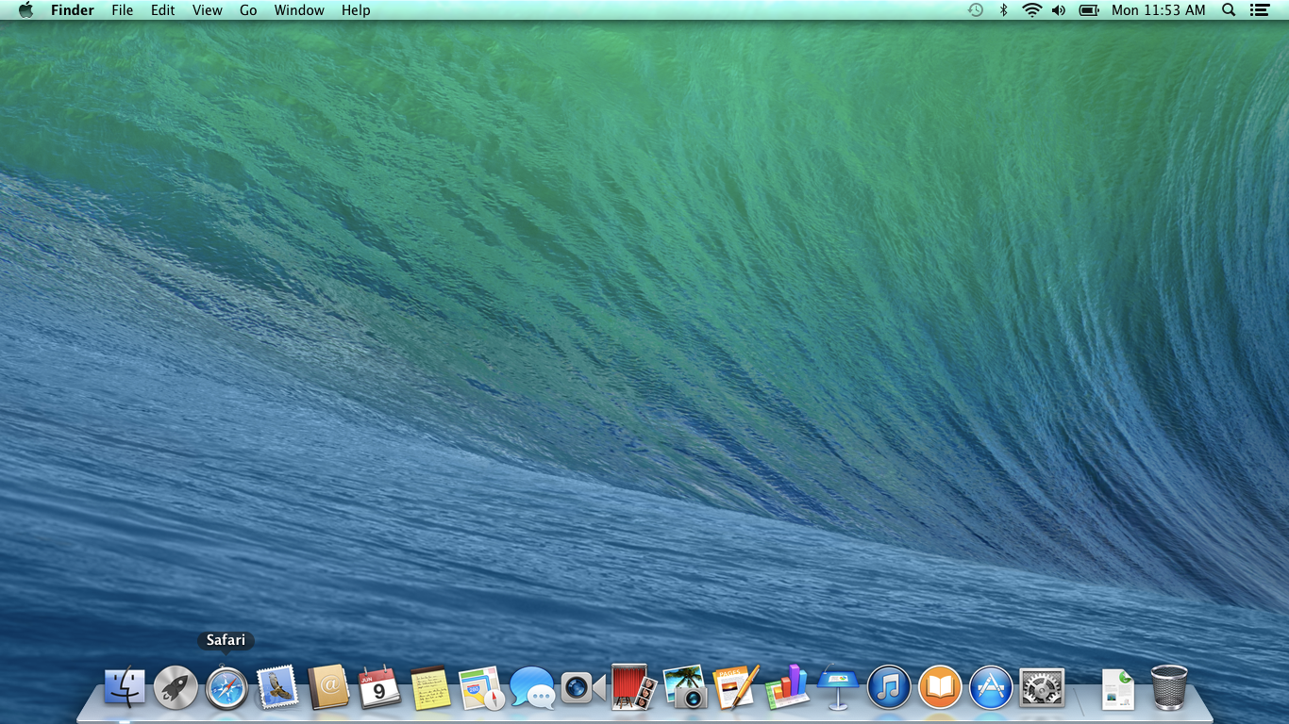

Slide 16
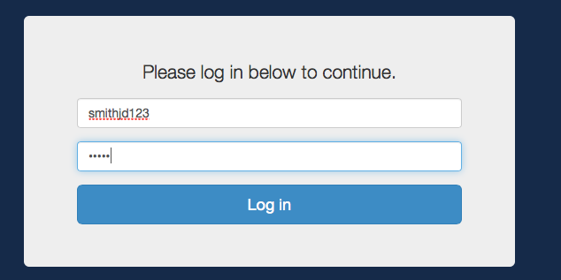
smithjd123
12345678 – Student ID #

Slide 17
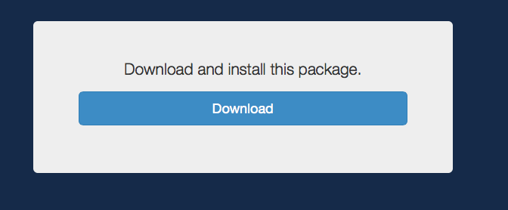

Slide 18
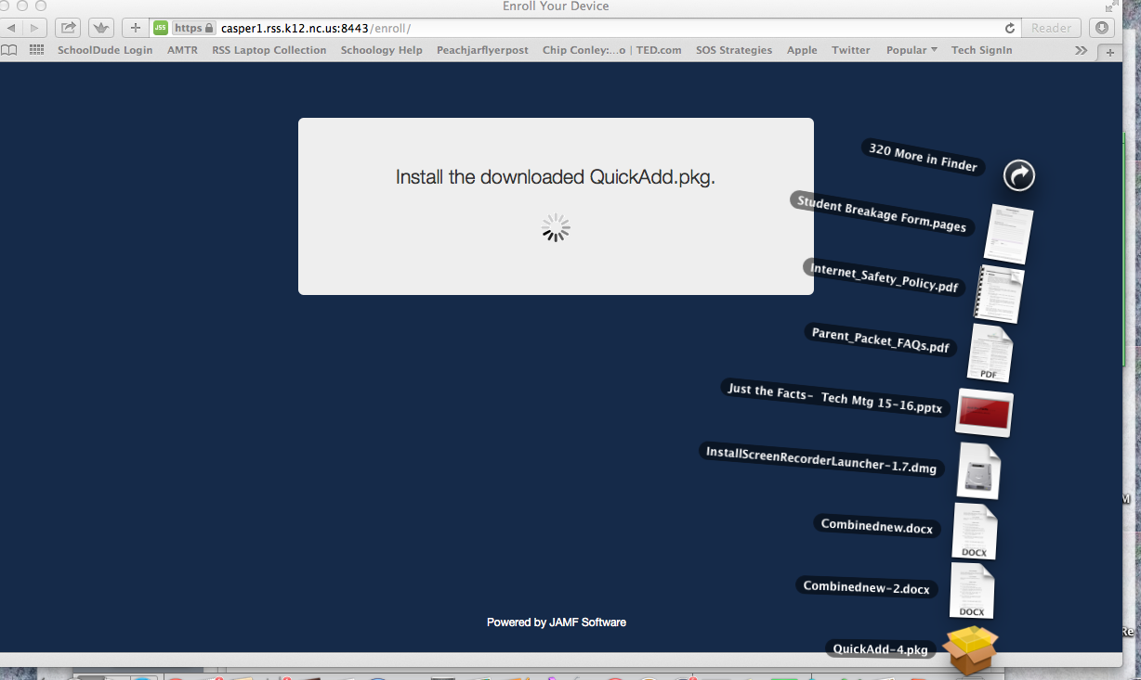

Slide 19
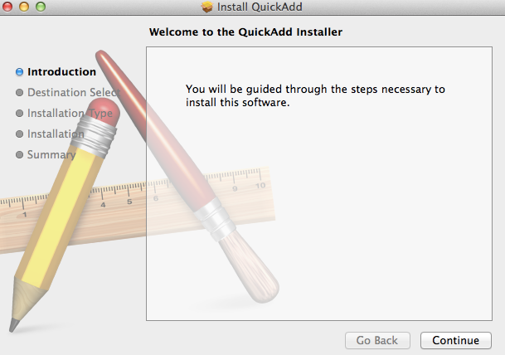
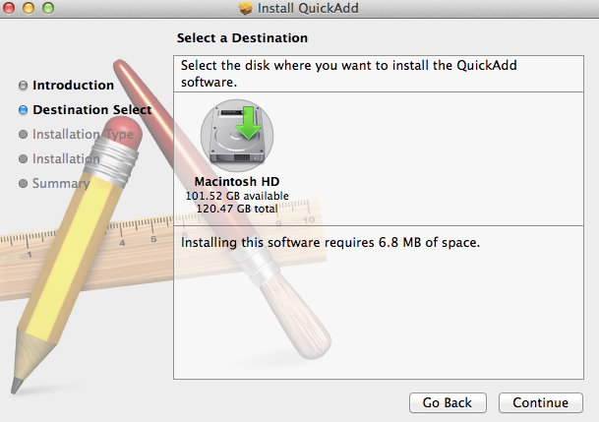
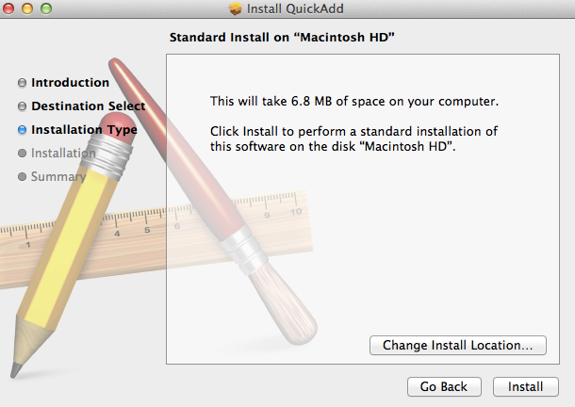

Slide 20
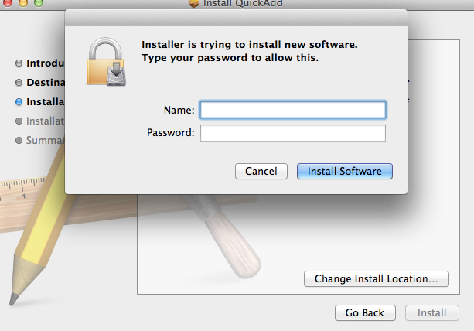
Enter the Computer Username/Password Here

Slide 21
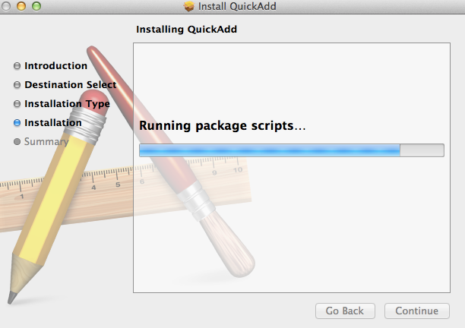

Slide 22
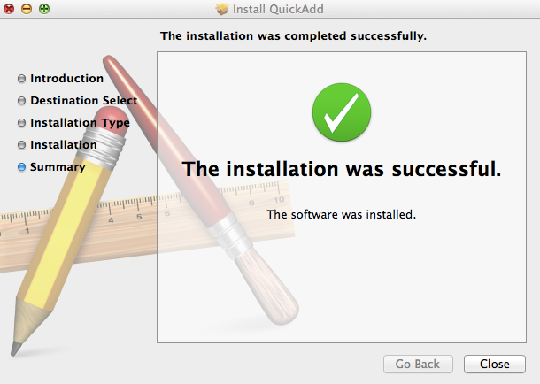
IF it says package FAILED…
1 - Open the Downloads folder. Drag the package into the TRASH. Empty the Trash.
2 - Go back to Safari /
Reload enroll.rss.k12.nc.us and do that process again.

Slide 23
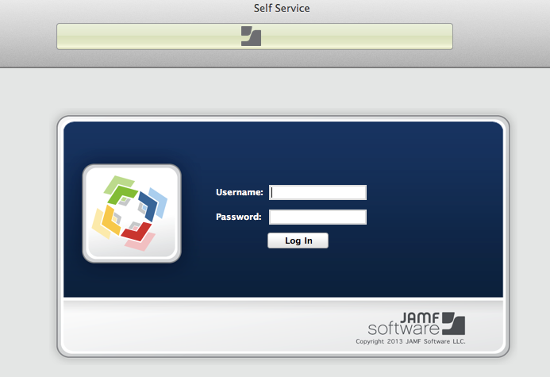
STOP HERE !!
Please leave your laptop OPEN and ON for about
5 minutes as we complete the process. The server is copying files to your computer.

Slide 24
GOOGLE/ZSCALER USERNAME
FOR ENROLL AND SELF SERVICE
Up to 15 characters of the last name
1st Initial of 1st name
1st initial of middle name
Last 3 digits of Student ID#
Zscaler is an internet filter.
You WILL need this info to
connect to internet at home. Please write your
Log-in Name ON your
Name Card.
GOOGLE/ZSCALER PASSWORD
FOR ENROLL AND SELF SERVICE
Student ID (or PowerSchool / NCWISE)

Slide 25
SELF SERVICE
ALLOWS YOU TO DOWNLOAD APPLICATIONS SUCH AS OFFICE PROCUCTS, ETC.
USE YOUR GOOGLE USERNAME & PASSWORD

Slide 26
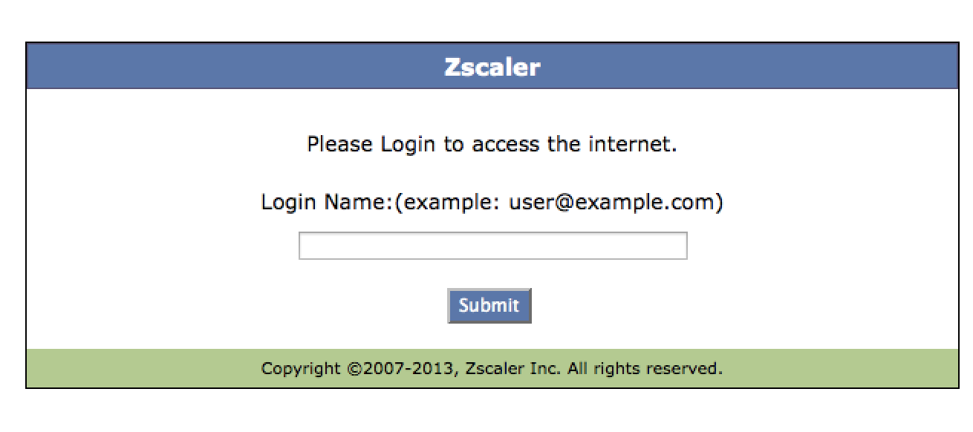
Filtering at home & outside of RSS
USE YOUR GOOGLE USERNAME@rss.k12.nc.us
& PASSWORD

Slide 27
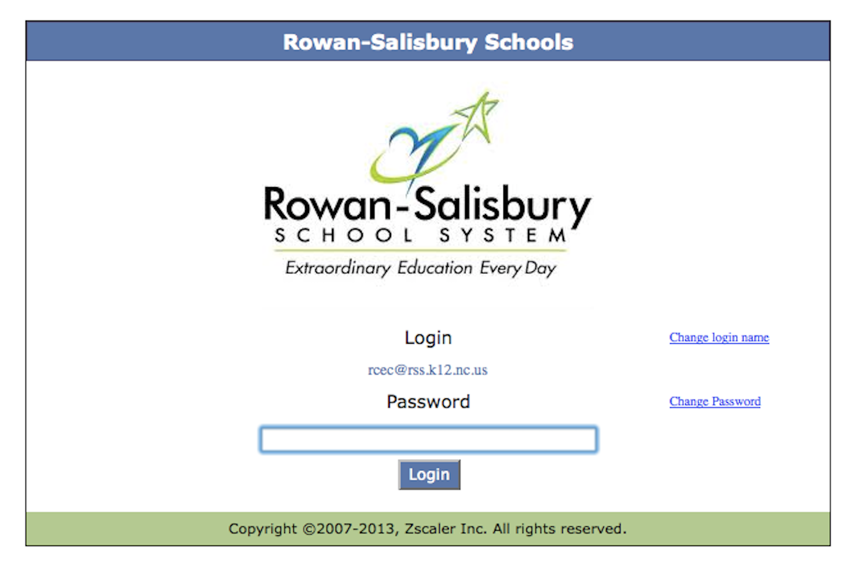
USE YOUR GoogLE USERNAME@rss.k12.nc.us & PASSWORD

Slide 28
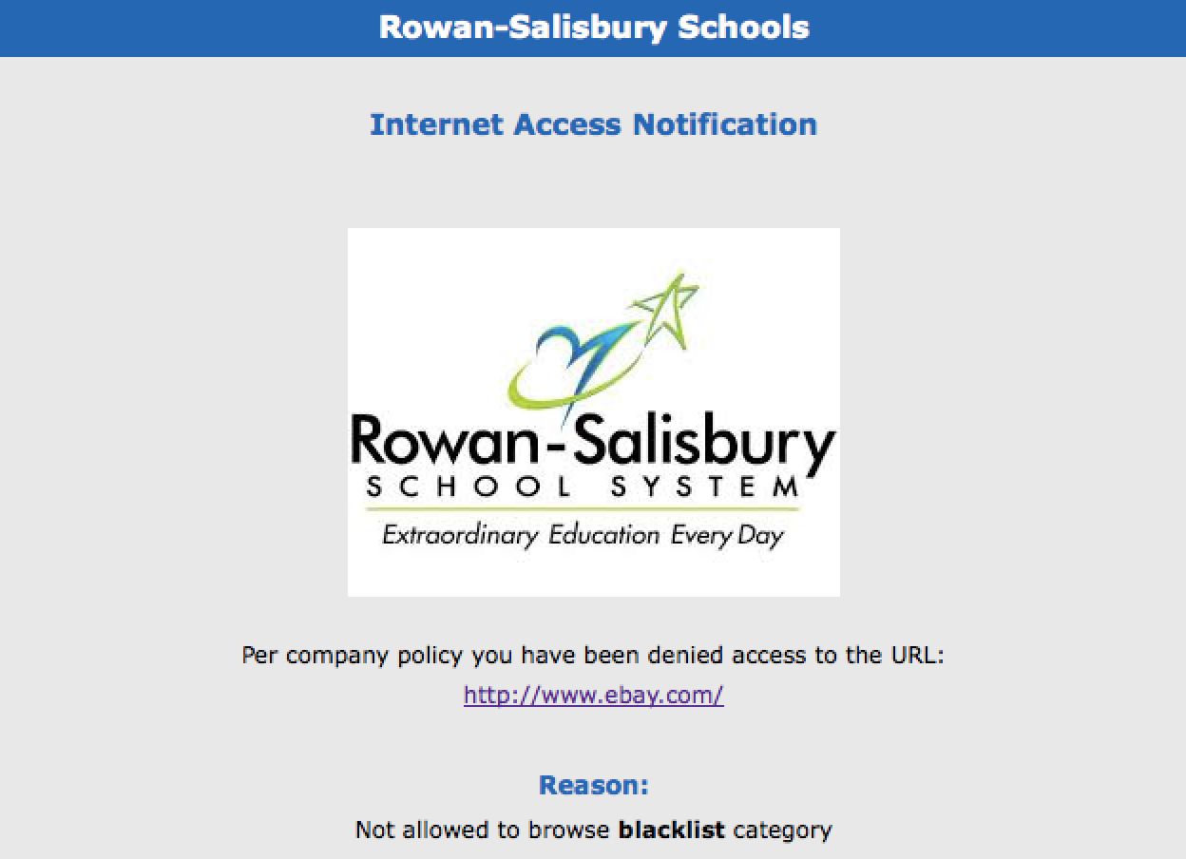
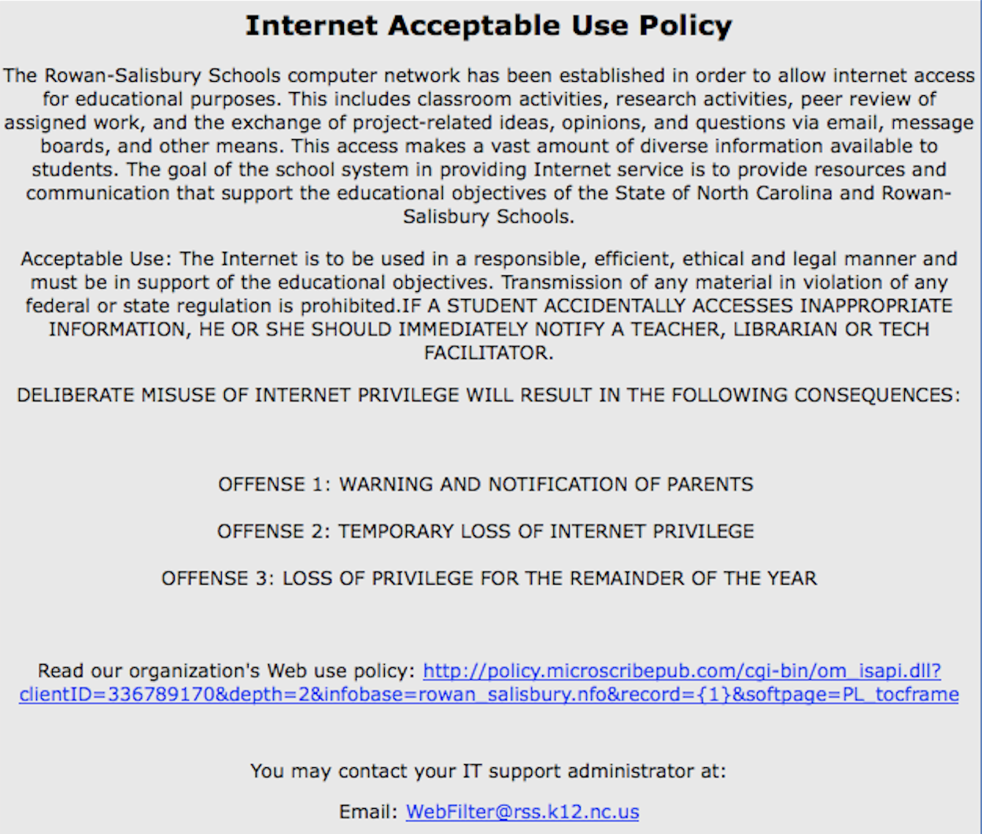

Slide 29
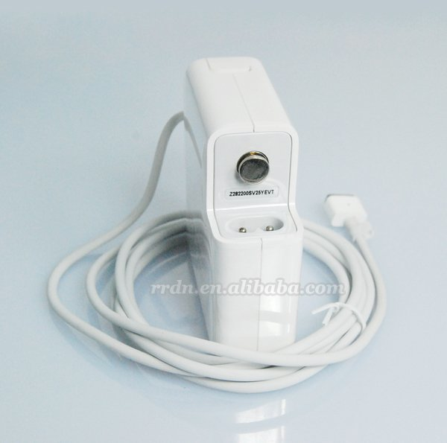
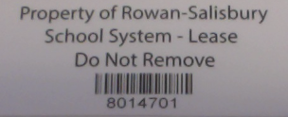
Record the Following INfo ON your TIcket
Fixed Asset Number
Charger Serial Number
Note any damage to your laptop / charger
Teacher VERIFY the FA #

