Slide 1
EOC/NCFE/CTE
Testing Laptop Preparations
Spring 2016

Slide 2
Setting Up You Device for Testing
Your teacher should have logged your computer in to the RSS Testing Account
You will now go through the steps to install Google Chrome and the NCTest Chrome App.
After you complete this, please restart your computer to log back in to your personal account.

Slide 3
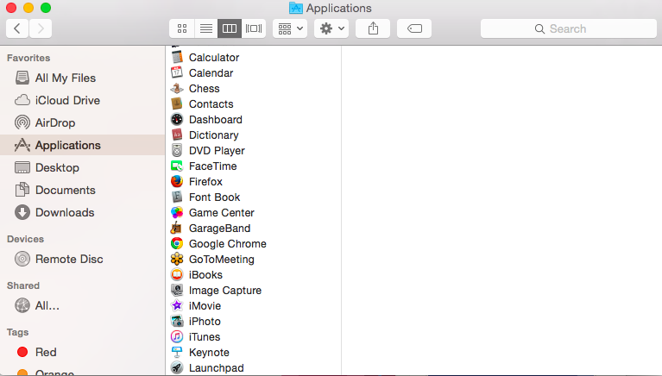
Google Chrome
Open Finder
Click on Applications
Make sure that Google Chrome is in the Applications Folder

Slide 4
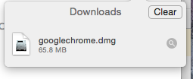
Download Google Chrome (if necessary)
Open Safari and key in Chrome Download
Make sure that you download from the following website -- https://www.google.go
On the website, click , then click
Chrome should begin downloading
When the download is complete, double click to install
Make sure that Google Chrome is in the Applications Folder

Slide 5
Download NCTest Add On in Chrome
Open Google Chrome
Google Search for NCTest App Chrome Store
Click on the Chrome Web Store Link
Install the NCTest App

Slide 6
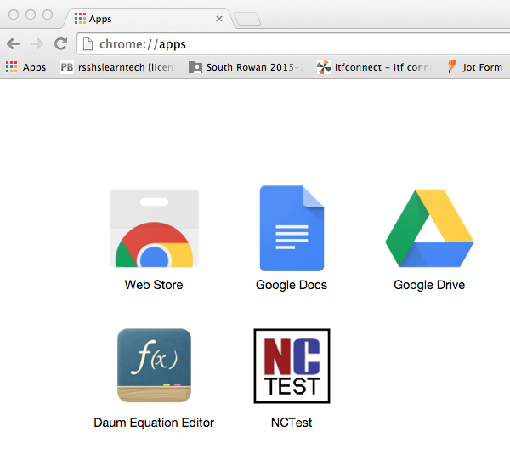
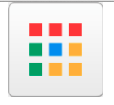
Check to Make Sure NCTest Installed
While still in Chrome…
Click on the Chrome Apps Launcher
Verify that you SEE the NCTest App

Slide 7
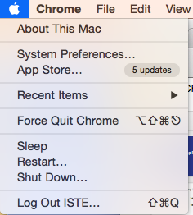
Settings for the Testing Account
Go to System Preferences under the Apple on the menu bar at the top

Slide 8
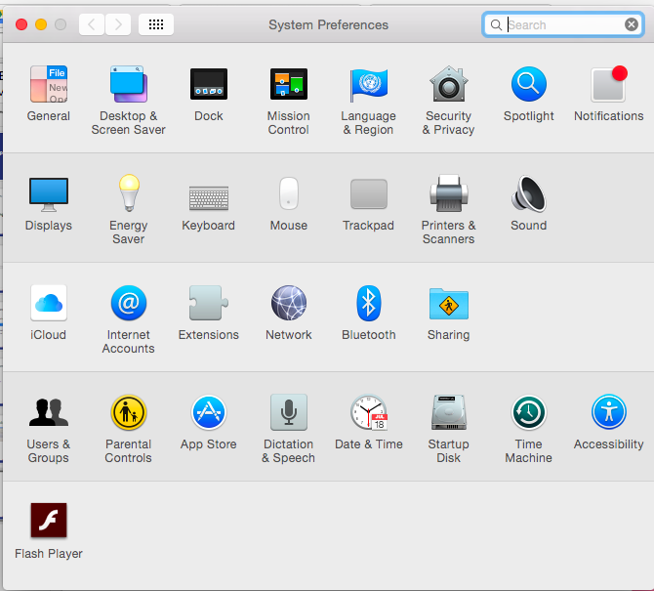
Click on Trackpad

Slide 9
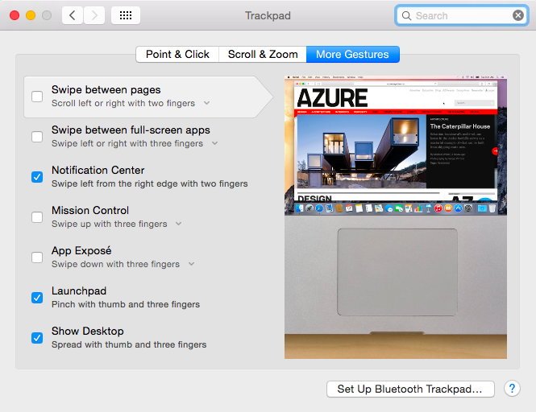
Click on More Gestures
Uncheck ALL the boxes:

Slide 10
Back to System Preferences (Show All)
Click on Security and Privacy

Slide 11
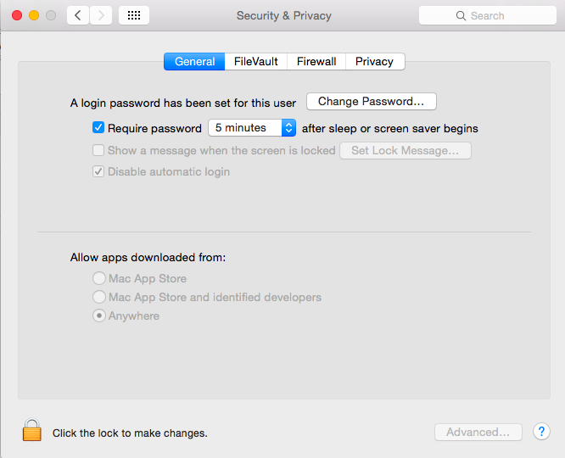
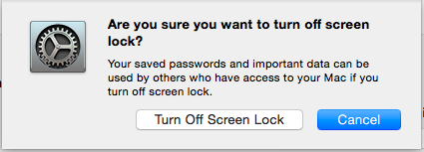
Click on the General Tab
Uncheck Require Password
Then, click Turn Off Screen Lock

Slide 12
Open Chrome and complete NCTest Tutorial
While still in Chrome…
Click on the Chrome Apps Launcher
Click on the NCTest App

Slide 13
Restart your computer!!!

